Slide 1
Traveling between UK and EU in the event of “no-deal”

Slide 2
Freedom of movement
"every citizen of the Union shall have the right to move and reside freely within the territory of the Member States subject to the limitations and conditions laid down” https://www.citizensinformation.ie/en/moving_country/
The UK government has announced that freedom of movement will end on the day of exit
Freedom of movement rules will most likely change affecting EU and UK citizens
When the UK leaves EU
UK will automatically become “a third country”
This will affect
Passports
Visas
Healthcare
Pets

Slide 3
UK citizens
Border checks, passports and visas
Additional checks when crossing borders
UK nationals will not be entitled to use the separate EU/EEA lanes
Passports need to have at least six months' validity left when traveling to EU
Can travel without a visa for three months
UK citizens would need a European Travel Information and Authorization Scheme (ETIAS), which would be similar to ESTA

Slide 4
EU citizens
Changes at the UK border
Tougher rules for criminals
All travellers have to make a customs declaration
Would not require a visa if staying less than 3 months
The use of EEA National identity card would no longer be possible
Longer queues at the border
Changes at what you can bring in your luggage

Slide 5
Other difficulties travelers might face
Healthcare
European health insurance card would no longer be valid
Driving license
Need for an international driving permit
Cost
The cost of travel is likely to increase
Using mobile phones will be more expensive

Slide 6
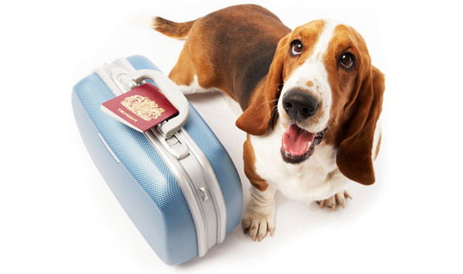
Traveling with pets
Pet passport program might not be valid
A lot more complex and possibly expensive
The british government advices pets owners to contact their vet at least four months before travel to an EU country.
People traveling with pets have to take into consideration the rules that EU has on infectious diseases.
At this time UK will not be changing the requirements for pets traveling from EU to the UK.

Slide 7
The rights of UK nationals and other residents
EU citizens
The UK government has guaranteed that EU citizens resident in the UK by exit day will be able to stay
Any EU citizen living in the UK will have until 31 December 2020 to apply for status under the scheme
EU citizens with pre-settled or settled status under the EU Settlement Scheme would be able to be joined in the UK under the scheme, by 29 March 2022
After 29 March 2022 they will be able to apply through the applicable UK Immigration Rules
This would bring the rights of EU citizens in line with the rights of UK nationals from 30 March 2022

Slide 8
The rights of UK nationals and other residents
UK nationals
The UK government is working on ensuring the rights of UK citizens living in the EU
UK nationals returning to the UK permanently will have access to NHS-healthcare the same way that people already living in the UK do
The UK continues to call on the EU and Member States to uphold their commitments to citizens and to protect the rights of UK nationals in the EU in the event of a ‘no deal’ scenario

Slide 9
https://www.youtube.com/watch?v=n0GEPxLvoP8
https://create.kahoot.it/kahoots/my-kahoots/folder/cdcc9d1a-55c5-42cf-aa8e-bf6978eff701

Slide 10
text:
https://brexit.gov.gr/wp-content/uploads/2019/04/factsheet_1_travel_en_final.pdf
https://www.reuters.com/article/uk-britain-eu-immigration/uk-plans-to-end-eu-freedom-of-movement-immediately-in-no-deal-brexit-idUSKCN1V91IN
https://edition.cnn.com/travel/article/how-brexit-will-affect-travel/index.html
https://www.thelocal.no/20190214/country-by-country-guide-to-what-brits-in-the-eu-can-expect-in-the-event-of-a-no-deal-brexit
https://www.politico.eu/article/citizens-rights-for-brits-in-the-eu-if-theres-no-brexit-deal/
https://assets.publishing.service.gov.uk/government/uploads/system/uploads/attachment_data/file/790570/Policy_Paper_on_citizens_rights_in_the_event_of_a_no_deal_Brexit.pdf
https://www.euronews.com/2018/09/14/no-deal-brexit-how-the-uk-government-says-consumers-would-be-hit
https://www.euronews.com/2019/01/10/what-would-a-no-deal-brexit-mean-for-citizens-rights
https://www.independent.co.uk/travel/news-and-advice/brexit-no-deal-travel-passport-visa-holiday-advice-ehic-mobile-roaming-a91274
31.html
https://www.gov.uk/government/publications/no-deal-immigration-arrangements-for-eu-citizens-moving-to-the-uk-after-brexit/no-deal-immigration-arrangements-for-eu-citizens-arriving-after-brexit
photo:
http://www.igcts.com/uk-government-warns-no-deal-brexit-could-mean-get-a-com-replacement-for-your-eu/
https://www.socialplatform.org/wp-content/uploads/2017/04/shutterstock_217298056.jpg
https://www.seatmaestro.com/wp-content/uploads/2015/02/traveling-with-animals.jpg

